Slide 1

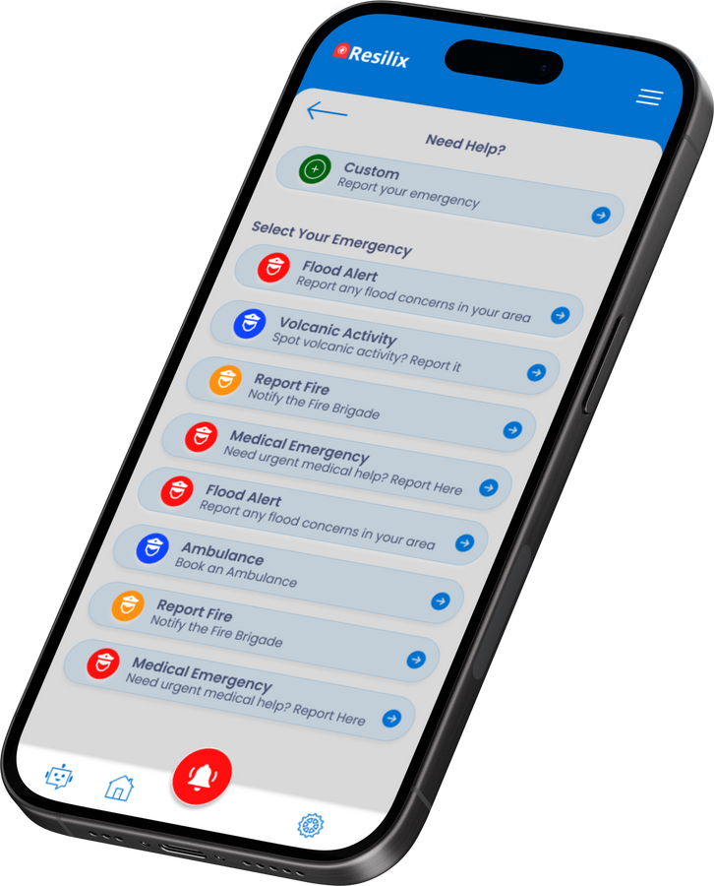
UI Design and Implementation
Disaster Management System
Presented by Group 25

Slide 2

Introduction
UX/UI is crucial in creating intuitive, efficient, and accessible applications that can potentially save lives during emergencies. Graphics: Icons representing each agenda point
Group Member's Name

Slide 3
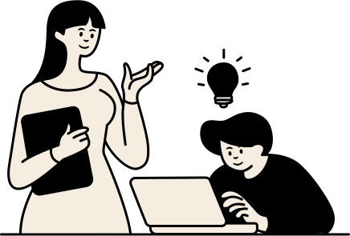

Here's our Design Process
Define Phase
Ideate
Prototyping and Refinement
Testing Phase
What we did first
What we did next
How we concluded
What we did further

Slide 4



Define Phase: Key Findings and Insights
Users need a simple and quick way to report emergencies.
Reliable location detection is crucial.
The interface must support both text and voice inputs for accessibility
User Personas
Name: Jane Etta
Age: 35
Occupation: Nurse
Tech Savviness: Moderate
Goals: Quickly report emergencies and receive timely help.
Pain Points: Difficulties in navigating complex interfaces during stressful situations.
Name: John Smith
Age: 45
Occupation: Firefighter
Tech Savviness: High
Goals: Efficiently receive and respond to emergency alerts.
Pain Points: Inconsistent information flow and delayed updates.
Name: Nfor Emmanuel
Age: 55
Occupation: Insurance Worker
Tech Savviness: High
Goals: Access to real-time data on incidents and emergencies to assess risk factors in different areas..
Pain Points: Inconsistent information flow and delayed updates.

Slide 5
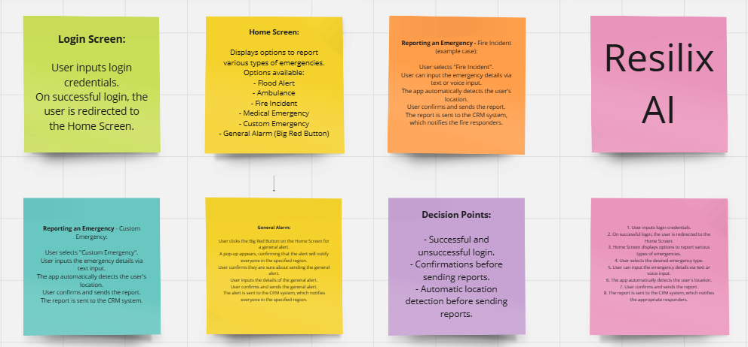
Ideate Phase
Prioritized features that would save time and improve accuracy in emergency reporting. Graphics: Mind maps, brainstorming session photos, initial concept sketches
Brainstorming Session
Brainstorming Techniques
User Journeys
Sketching
User stories

Slide 6
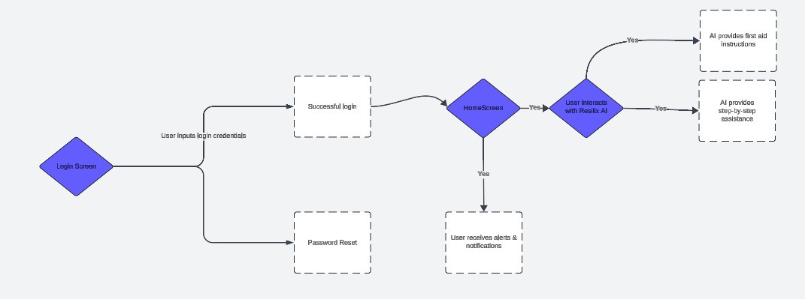
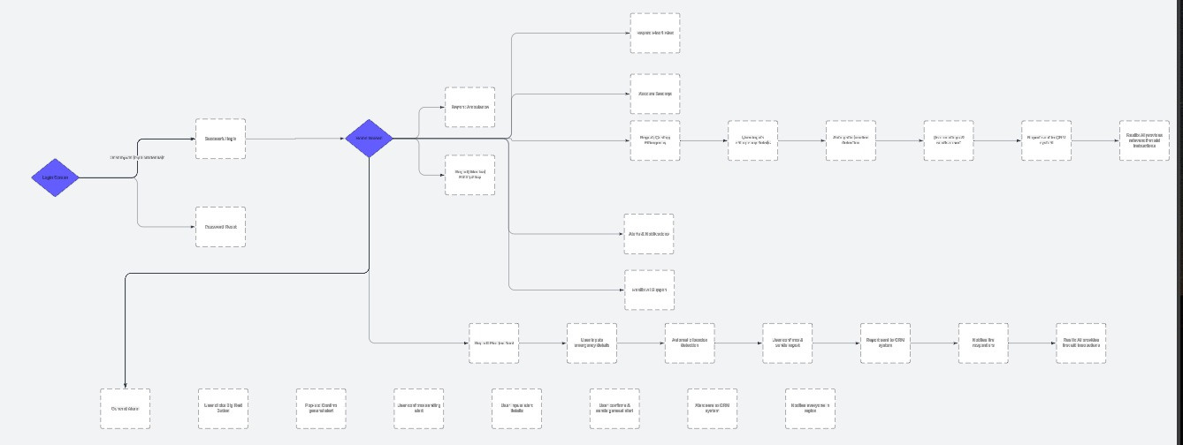
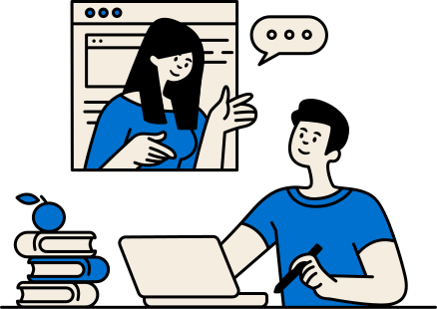
USER FLOW: Resilix AI Assistant
User Flow/Journey Map
The user flow diagram illustrates the key interactions a user will have with the Resilix app, from logging in to reporting emergencies and receiving real-time alerts.

Slide 7
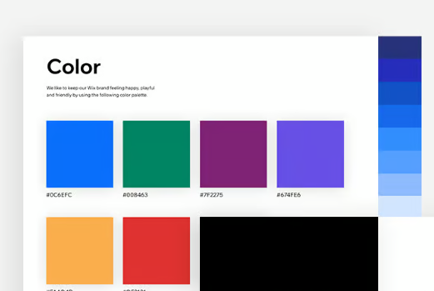
Visual Design Guidelines
Typography: Poppins fonts
Color Scheme: Blue and red tones for urgency and clarity
Icons and Imagery:
Simple, intuitive icons for emergency types
Realistic imagery for alerts and notifications
Blue is often associated with trust, reliability, and safety, making it an ideal choice for an emergency response application.
Red is universally recognized as a color for warnings and alerts

Slide 8

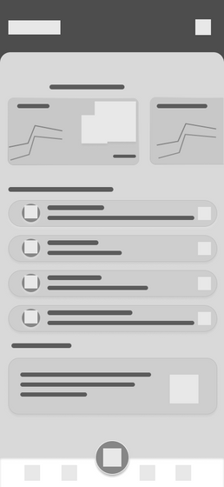
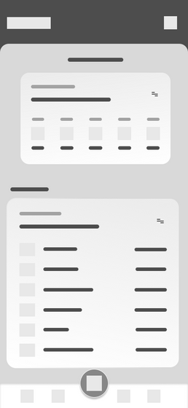


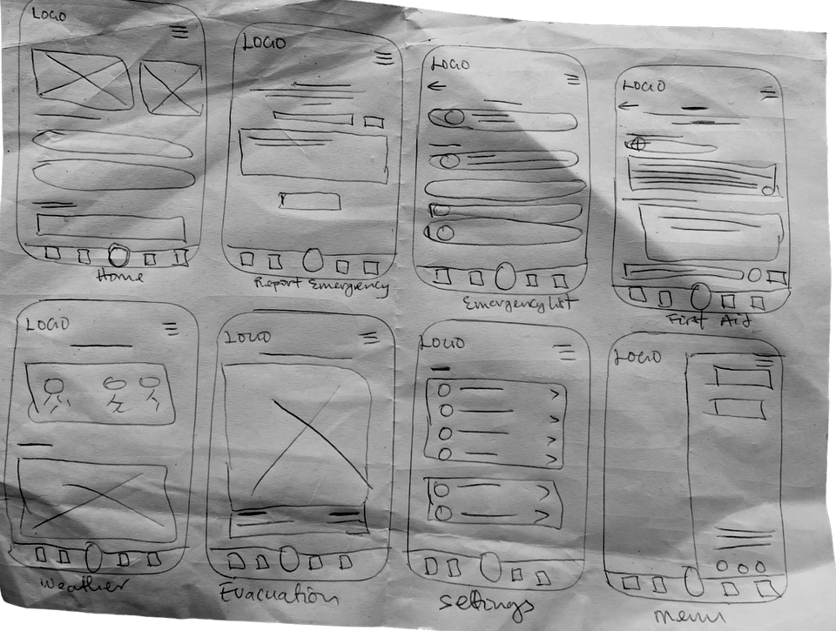


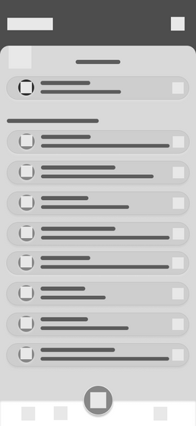
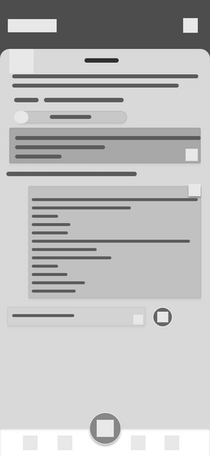
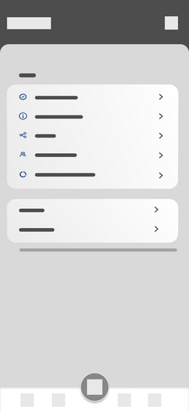
Wireframes
Started with rough sketches to outline basic layout and functionality.
Progressed to digital wireframes for better visualization and iteration.

Slide 9

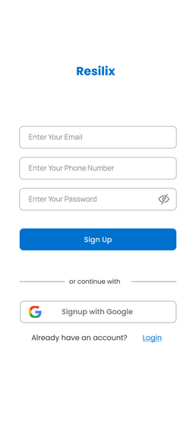
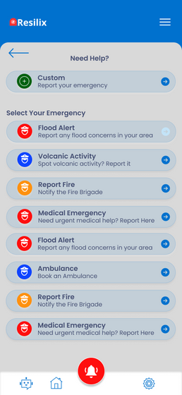
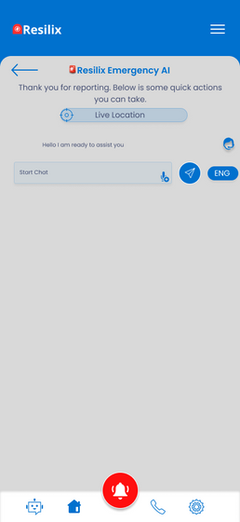
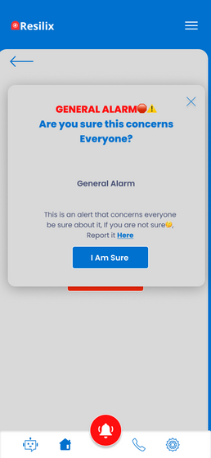
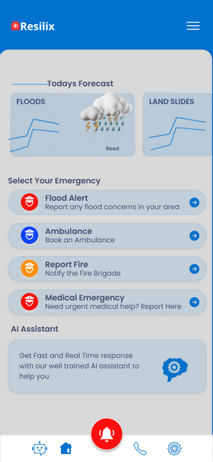
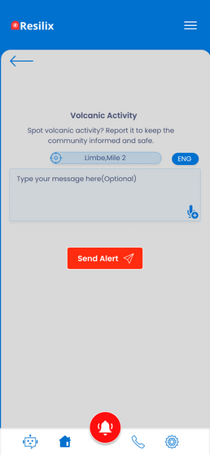
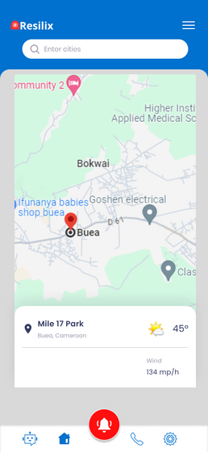
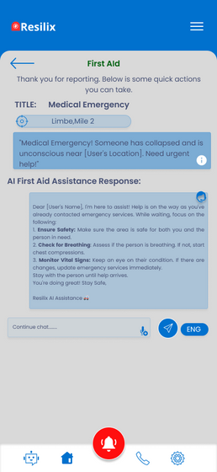
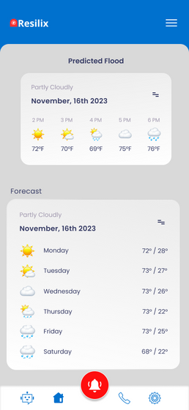
High Fidelity

Slide 10
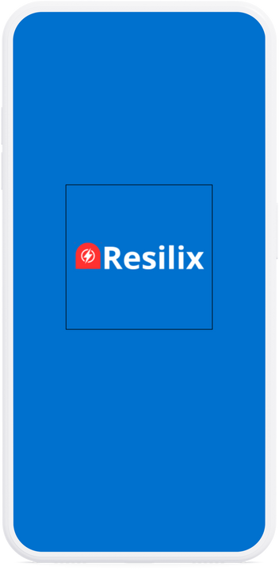
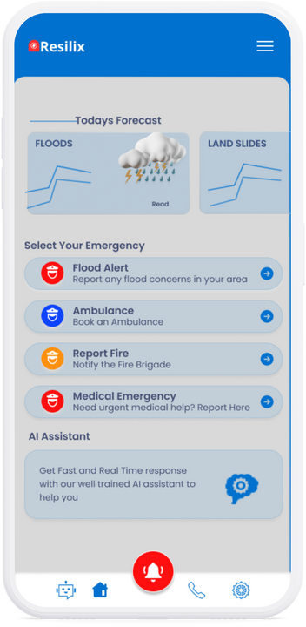
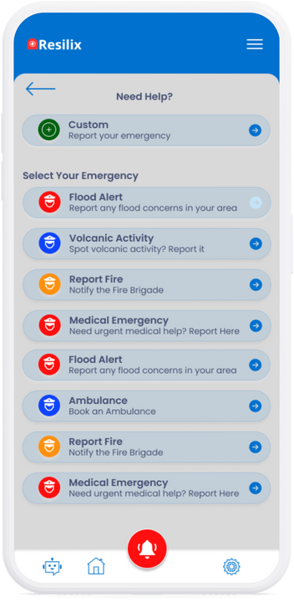
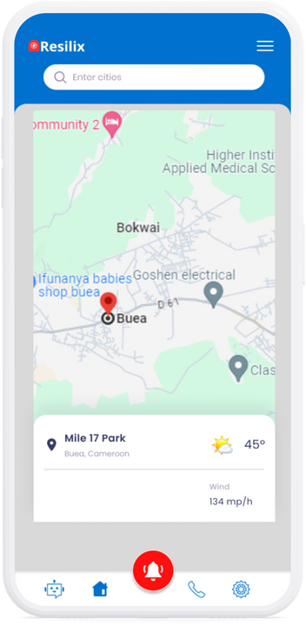
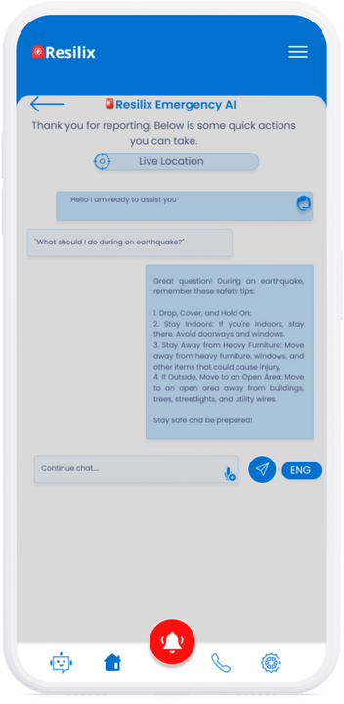
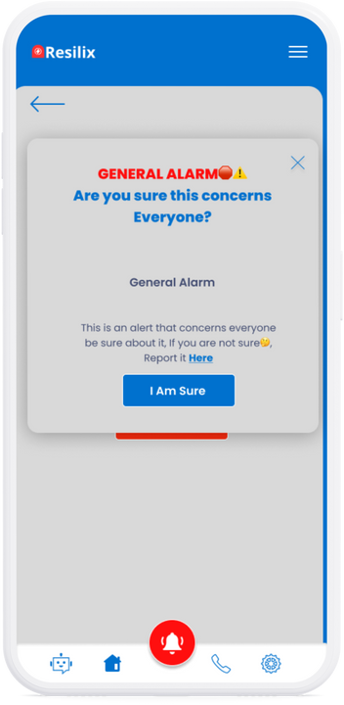
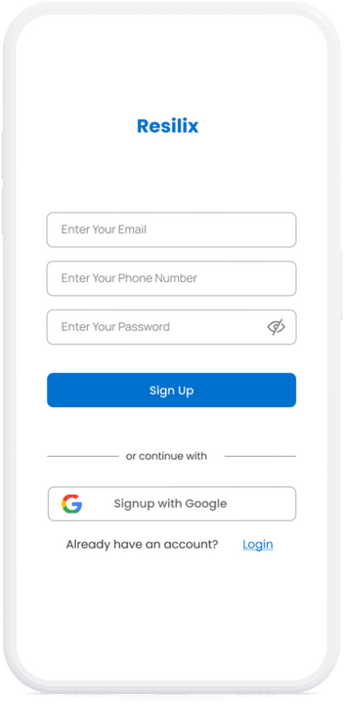
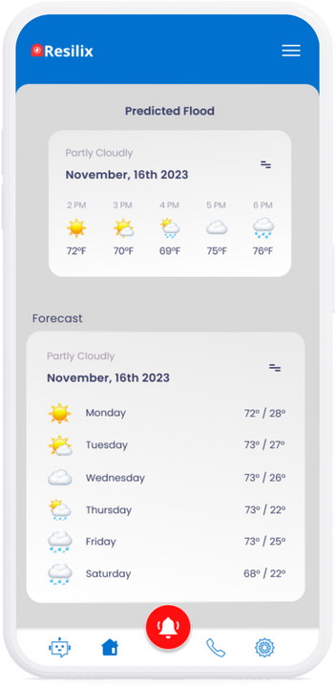
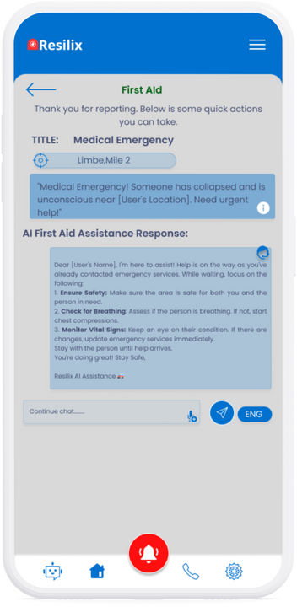
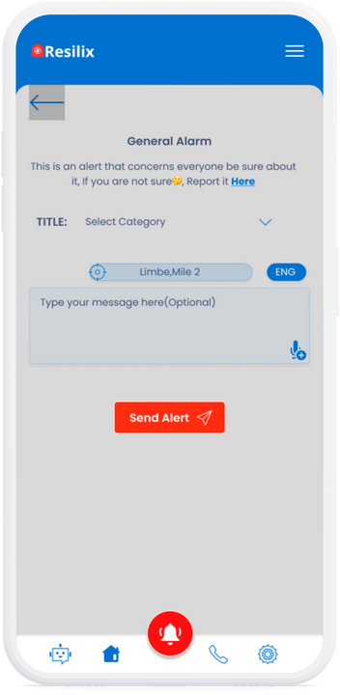
Prototyping and Refinement

Slide 11

Testing Phase
Usability Testing Methodology:
Conducted with a diverse group of stakeholders to ensure accessibility.
Included task-based tests to observe user interaction with the app.
Key Findings and Improvements:
Identified and fixed minor usability issues.
Stakeholders appreciated the simplicity and intuitive design.
Accessibility Considerations
Ensured the app is usable by people with disabilities.
Implemented voice input and clear, readable text.

Slide 12
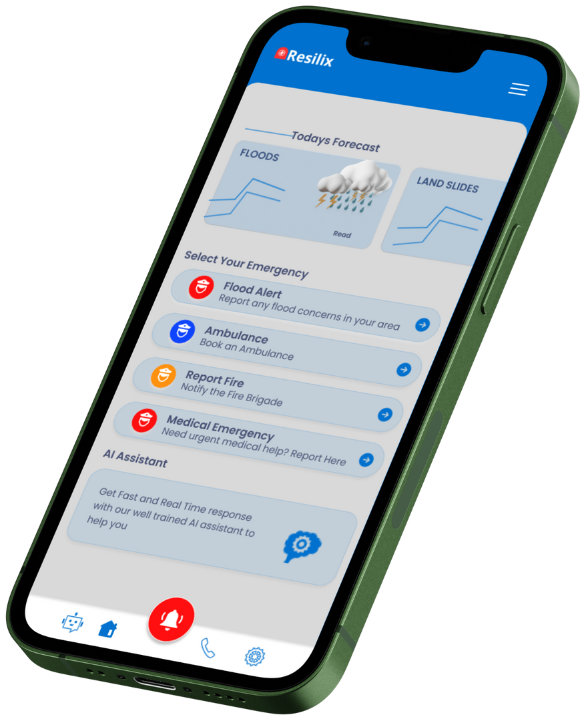
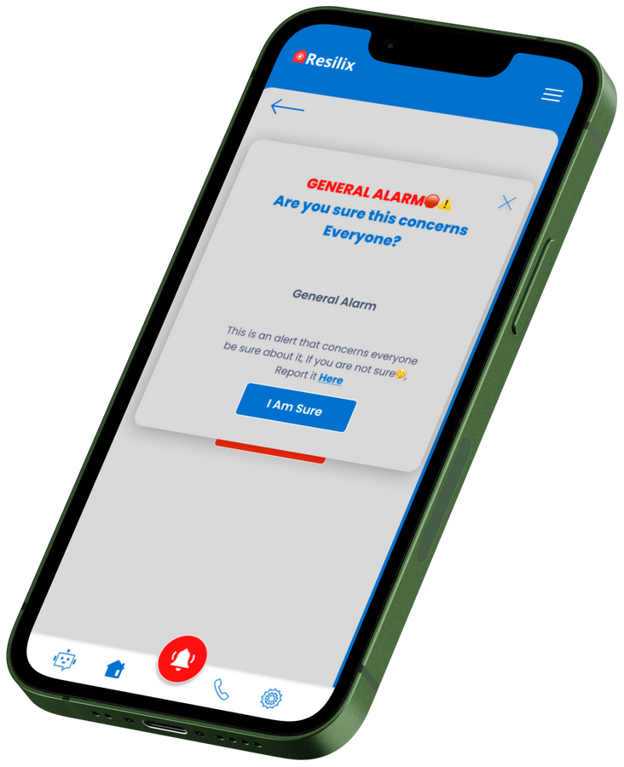
Conclusion
By adhering to our detailed design guidelines and user-centered approach,
we ensure that the app meets the needs of our target audience while providing an intuitive and
accessible experience

